Slide 1
DevOps a tools perspective
R. Michael Querimit
Developer Tools Technical Specialist

Slide 2
“DevOps is the union of people, process, and products to enable continuous delivery of value to our end users.” - Donovan Brown
Brown, Donovan. “What is DevOps?” September, 1, 2015. http://bit.ly/WhatIs-DevOps.
Notes:
Every organization needs a definition. Donovan Brown came up with this one, but organizations should determine the definition that is inline with their business priorities.
It’s a Philosophy….
It’s a change to the “ABC’s” of a company – specifically in IT, but also in the business (move faster)
Attitudes towards continuous flow
Behaviors that support the change desired
Culture that results

Slide 3
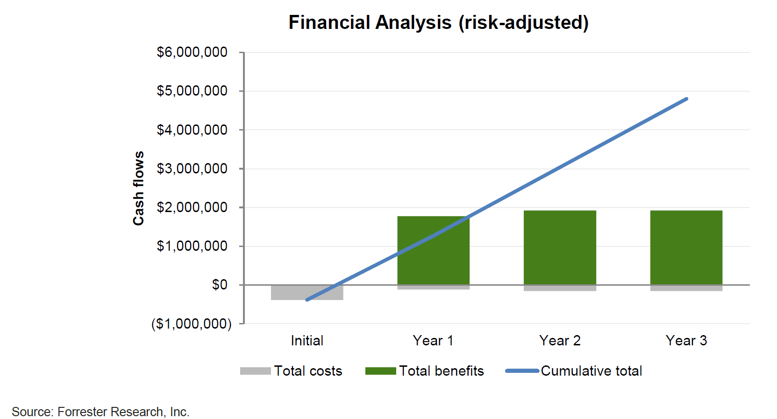

SUMMARY OF TEI
THE MICROSOFT DEVOPS SOLUTION
$3.9M
IN NET PRESENT VALUE OVER THREE YEARS
For a composite organization based on surveys and interviews of actual Microsoft customers by Forrester Consulting.
529%
three-year, risk-adjusted ROI
Time-to-recover from failures:
down 80%
Increase in deployment frequency:
up 15x
3 months
for payback

Slide 4
DevOps – delivering value in the digital era
22%
29%
50%
75.2x
less time on unplanned work/rework
more time spent on new work
less time remediating security issues
fewer outage costs due to downtime
Employees are 2.2x more likely to recommend their organization as a great place to work
Notes:
Digital-minded organizations are adopting DevOps practices as the vehicle for delivering transformation, and are reaping the benefits from doing so.
High-performing organizations spend 22 percent less time on unplanned work and rework. As a result, they are able to spend 29 percent more time on new work, such as new features or code. They are able to do this because they build quality into each stage of the development process through the use of continuous delivery practices, instead of retrofitting quality at the end of a development cycle.
High performers spend 50 percent less time remediating security issues than low performers. By better integrating information security objectives into daily work, teams achieve higher levels of IT performance and build more secure systems.
And a final differentiator – by adopting DevOps standards and practices, employees are 2.2x more likely to recommend their organization as a great place to work.
Source: 2016 State of DevOps Report (Puppet & Dora), survey of 4,600 technical professionals

Slide 5


Visual Studio Enterprise
for DevOps Practitioners

Slide 6
DevOps “habits” and “practices”
RECOMMENDED PRACTICES
CODE METRICS
TEST AUTOMATION
CODE STYLE RULES
PEER CODE REVIEWS
CONTINUOUS INTEGRATION
CONTINUOUS UNIT TESTING
ARCHITECTURAL VALIDATION
REC.PRACTICES
CLOUD INFRASTRUCTURE
DEVELOPER SANDBOX
CLOUD DEV/TEST LABS
CONTAINERIZATION
MICROSERVICES
AUTOSCALING
FAILOVER
RECOMMENDED PRACTICES
USER TELEMETRY
USAGE MONITORING
CONTINUOUS LEARNING
STAKEHOLDER FEEDBACK
A/B TESTING IN PRODUCTION
RECOMMENDED PRACTICES
CONTINUOUS INTEGRATION
CONTINUOUS DEPLOYMENT
RELEASE MANAGEMENT
CONTINUOUS TESTING
FLOW OF CUSTOMER VALUE
AUTONOMY & ALIGNMENT
BACKLOG improved by LEARNING
EVIDENCE gathered in PRODUCTION
MANAGED TECHNICAL DEBT
PRODUCTION FIRST MINDSET
INFRASTRUCTURE is a FLEXIBLE RESOURCE
RECOMMENDED PRACTICES
SELF-MANAGING TEAMS
PLANNING CHATS
FEATURE CREWS
SPRINT RITUALS
SCALED AGILE
TEAM ROOMS
RECOMMENDED PRACTICES
TESTING IN PRODUCTION
STAKEHOLDER FEEDBACK
USAGE MONITORING
USER TELEMETRY
FEATURE FLAGS
RECOMMENDED PRACTICES
APPLICATION PERFORMANCE MGMT
CONFIGURATION MANAGEMENT
INFRASTRUCTURE AS CODE
AUTOMATED RECOVERY
CONTINUOUS DELIVERY
RELEASE MANAGEMENT

Slide 7
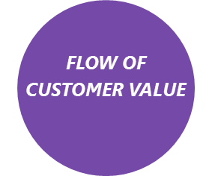
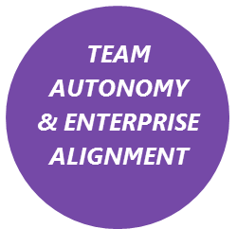
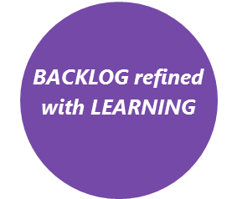
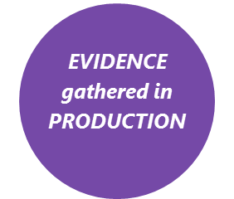
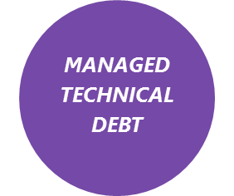
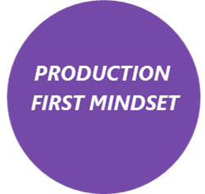
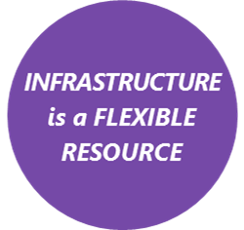
Recommended DevOps Practices | Continuous Integration Continuous Testing Continuous Deployment Release Management | Self-Managing Teams Feature Crews Scaled Agile | Continuous Learning Testing (in Production) Continuous Feedback | Usage Monitoring Telemetry Collection Experimentation Testing in Production Continuous Feedback | Code Quality Analysis Peer Code Reviews Automated Testing Architecture Validation Code Style Rules | Continuous Testing Continuous Delivery App Performance Mgmt. Infrastructure as Code Automated Recovery | Cloud Infrastructure Developer Sandboxing Cloud Dev and Test Infrastructure as Code Automatic Scaling
Visual Studio Features | Flexible Source Control Git, Github, remote Git or TFVC (Distributed or centralized source control) Modern Code Workflows Pull requests, branch policies, code reviews, checkin policies, code collaboration Cross-Platform Build Supports iOS, Android, Java, OS X, Linux, .net Flexible and extensible Cloud or on-premises CI builds Parallel builds Automated Testing Unit tests Selenium tests Xamarin Test Cloud (Automated Device Testing) Test Result Analysis HockeyApp | Agile Tools Kanban Boards Scrum/Task Boards Work Item Tracking Portfolio Management Capacity Planning Enterprise Collaboration Team Rooms Code Collaboration Code reviews Test & Feedback Dashboards & Charts Any platform, any code, any language, any app Code Search | Test & Feedback Exploratory Testing Feedback Management Stakeholder Feedback Inline test execution and creation from Agile boards Web based test execution Application Insights App telemetry Usage analytics HockeyApp Beta Test Distribution Feedback Collection | Test & Feedback Manual Testing Exploratory Testing Test Case Management Feedback Management Application Insights App telemetry Usage analytics HockeyApp Beta Test Distribution Feedback Collection | Modern Code Workflows Pull requests, branch policies, code reviews, checkin policies, code collaboration Test & Feedback Manual Testing Exploratory Testing Test Case Management Feedback Management Automated Testing Unit tests Selenium tests Xamarin Test Cloud (Automated Device Testing) Test Result Analysis | Automated Testing Unit tests Selenium tests Xamarin Test Cloud (Automated Device Testing) Test Result Analysis Test & Feedback Manual Testing Exploratory Testing Test Case Management Feedback Management Application Insights App telemetry Usage analytics HockeyApp Beta Test Distribution Feedback Collection | Cloud Dev/Test Environments Azure Dev/Test Labs Azure VMs Azure App Services Azure Resource Manager
 | Release Management +1 Concurrent pipeline Rolling deployments CodedUI Testing Performance & Load Testing Cloud Load Testing Code Coverage Intellitest Fakes&Stubs |  | IntelliTrace (in Production) Performance & Load Testing Test Case Management Cloud Load Testing | IntelliTrace (in Production) Performance & Load Testing | RT/Live Experiences: RT Architecture Validation RT Continuous Testing RT Style & Code Analysis IntelliTest IntelliTrace Code Maps Visual Debugging Code Analysis Code Coverage Package Management | Release Management +1 Concurrent pipeline Rolling deployments Performance & Load Testing Cloud Load Testing | Lab Management Performance & Load Testing Cloud Load Testing
Features in red =
Sold separately

Slide 8
Visual Studio DevOps
Walkthrough

Slide 9
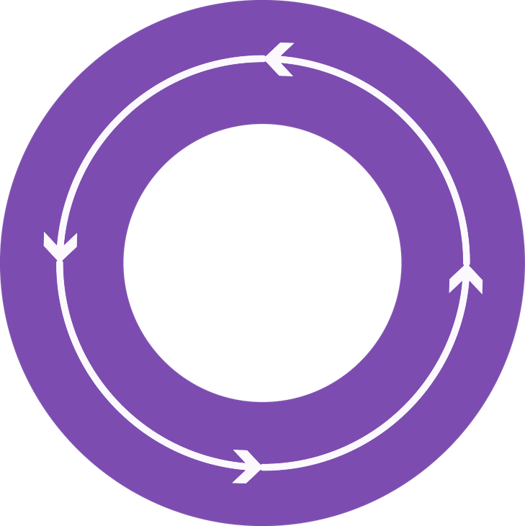



End-to-end DevOps
1
4
Plan
Monitor + Learn
Development
Operations
2
3
Develop + Test
Release

Slide 10
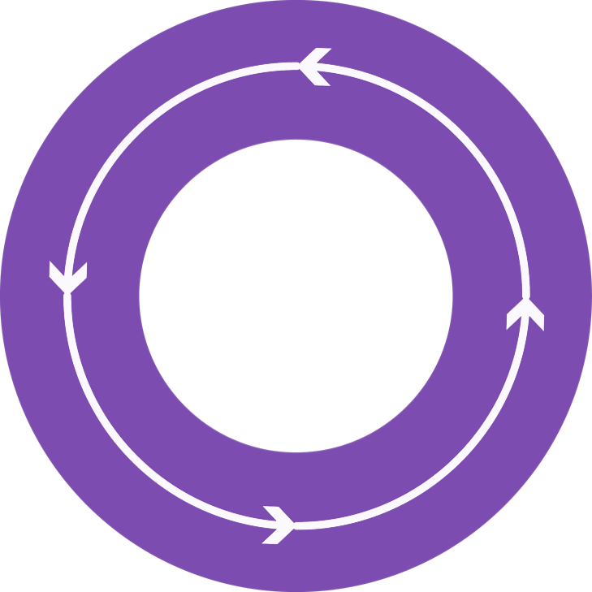
Plan
It starts with an idea - and a plan how to turn this idea into reality…
Project starts
Manage work
Develop + Test
1
Track progress
Plan

Slide 11
Develop + Test
When the iteration starts, developers turn great ideas into features …
2
Write code
Unit testing
Version control
Build
Build verification
Release

Slide 12
“Shift left”
Code editing
Debugging
Unit testing
Code analysis
Source control
Continuous integration
Continuous deployment
public async Task<int>
{int x = await task;
<//>
Continuous integration + real-time experiences = shift left

Slide 13
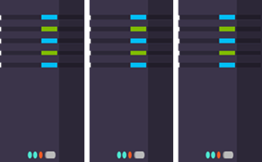
Release
When all tests pass, the build is deployed to testing environments for each stage in the release process
Cloud load testing
Integration testing
environment
Staging
environment
3
Monitor + Learn
Automated functional testing environment
Pre-production environment

Slide 14
Monitor + Learn
Learn and understand how users use your app, how it reacts and quickly fix issues and bugs
Plan the next iteration
Feedback
Monitor
4

Slide 15
Demo
Azure Dev Ops Project

